Slide 1
The first Hub for Developers
SQL Databases
Miltos Vafiadis
Code.Learn:
.Net Academy

Slide 2

Agenda
Definition of Databases
Database Types (SQL Database)
Database Models (Relational Model)
Database Management Systems (MS SQL Express 2017)
Structure Query Language (T-SQL)
Fun Exercise!

Slide 3
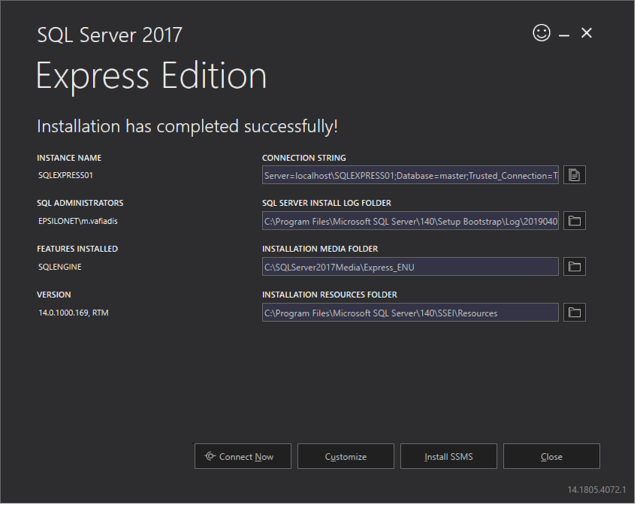

Prerequisites
Download / Install:
>> Microsoft SQL Server 2017 - Express Edition
Basic Installation (unless you already have other versions / instances)
Note: Version 14.0 refers to 2017
>> Microsoft SQL Server Management Studio
(SSMS)
https://www.microsoft.com/en-us/sql-server/sql-server-editions-express
Prerequisites

Slide 4

What is a Database?
“Database is like a Candy Jar. You take different kinds of candy and put into that jar and anytime you need a particular kind,
say a chocolate bar,you go to that Jar and take it, only if you, or someone else has put it there before"
… a collection of information that is organized so that it can be easily accessed, managed and updated
… organized into rows, columns and tables
…indexed to make it easier to find relevant information
… data gets updated, expanded and deleted as new information is added
“A complex set of interrelational data structures allowing data to be lost in many convenient sequences while retaining a complete record of the logical relations between the missing items”
Databases

Slide 5

SQL Databases
Performance
Scalability
STORAGE - store related data in tables
SCHEMA
require a schema which defines tables prior to use
encourage normalization to reduce data redundancy
FETCH DATA
use a powerful declarative language for querying
Related Data - support table JOINs to retrieve related data from multiple tables in a single command
DATA INTEGRITY
implement data integrity rules
provide transactions to guarantee two or more updates succeed or fail as an atomic unit
ACID (Atomicity, Consistency, Isolation, Durability) is a set of properties of database transactions intended to guarantee validity even in the event of errors, power failures, etc
SCALABILITY - can be scaled (with some effort)
Databases

Slide 6
NoSQL Databases
SQL
ACID
STORAGE - store related data in JSON-like, name-value documents
SCHEMA
can store data without specifying a schema
must usually be denormalized so information about an item is contained in a single document
FETCH DATA
use JSON data objects for querying
Related Data - should not require JOINs (presuming denormalized documents are used)
DATA INTEGRITY
permit any data to be saved anywhere at anytime without verification
guarantee updates to a single document - but not multiple documents
SCALABILITY - provide excellent performance and scalability
Databases

Slide 7
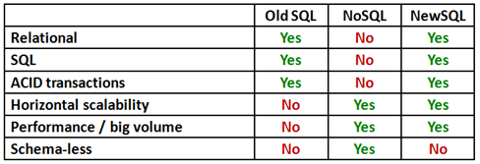
NewSQL Databases
Promise to provide:
the same scalable performance of NoSQL systems for online transaction processing (OLTP) read-write workloads
while still maintaining the ACID guarantees of a Traditional database system
https://dataconomy.com/2015/08/sql-vs-nosql-vs-newsql-finding-the-right-solution/
Databases

Slide 8
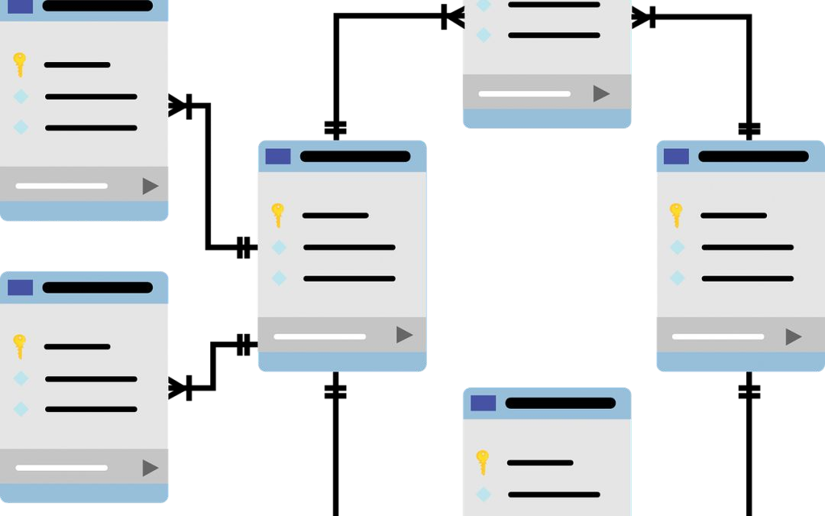
Relational (SQL) Databases
Relational Model
Table
Relationships
Schema
Column
Key (Primary, Foreign)
Indexes
Constraints
RDBMS

Slide 9
Relational Model
IBM Research - Edgar Frank "Ted" Codd - 1969
Tables with rows and columns
Rows are also called Tuples or Records
Columns are also called Fields or Attributes
Spreadsheet vs Database Table
Relationships among tables to efficiently store a large amount of data and effectively retrieve it
other database models: hierarchical, network, object
Relational (SQL) Databases

Slide 10
Tables
A table is a collection of related data held in a structured format within a database. It consists of columns and rows
Equivalent to Relation in Relational Model
Columns
Rows
Keys (Primary - Composite, Foreign)
Relational (SQL) Databases

Slide 11
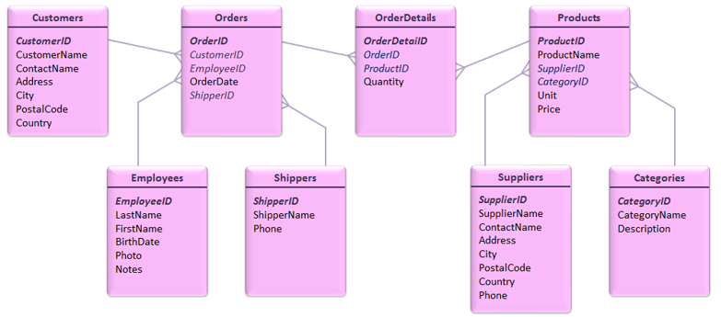
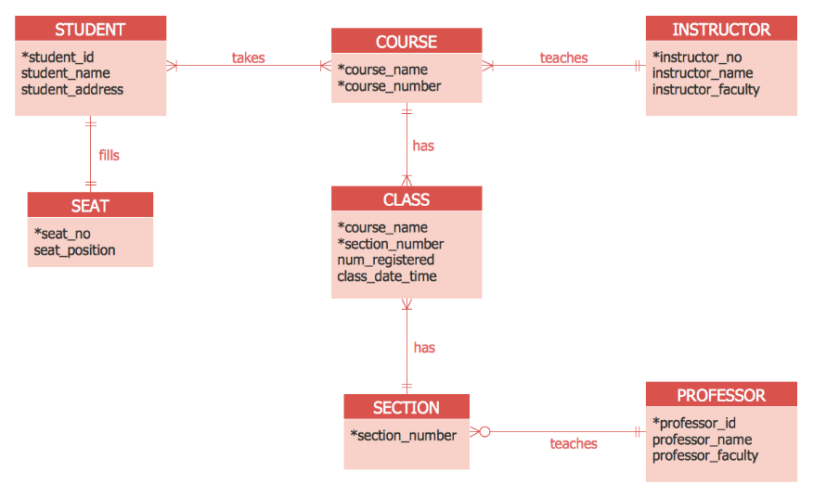
Relationships
Types of Relationships
One to One Relationships
One to Many Relationships
Many to Many Relationships
Self Referencing Relationships
Entity Relationship Diagram (ERD)
A diagram used to represent
all the entities/tables with their attributes/fields
the relationships between these entities
Relational (SQL) Databases

Slide 12
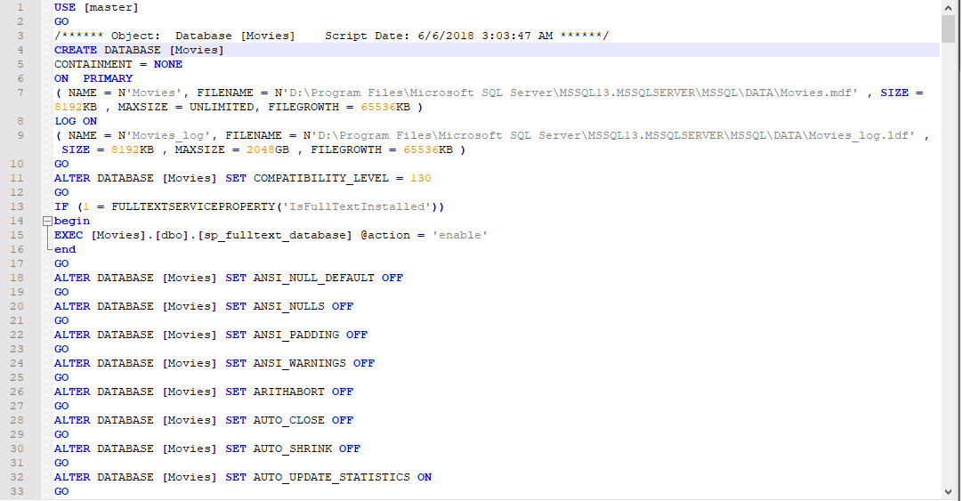
Schema
T-SQL
The database schema of a database system is its structure described in a formal language supported by the database management system (DBMS).
The term "schema" refers to the organization of data as a blueprint of how the database is constructed.
Relational (SQL) Databases

Slide 13
Indexes
What is an index
On-disk structure associated with a table or view
Purpose
Speed retrieval of rows
Clustered
The rows are stored physically on the disk in the same order as the index
There can be only one clustered index
Fast to get data, but slower when writing to a table
Nonclustered
With a non clustered index there is a separate structure (list) that has pointers to the physical rows
You can have many non clustered indexes
Each new index will increase the time it takes to write new records
Relational (SQL) Databases

Slide 14
Constraints
SQL constraints are used to specify rules for data in a table:
NOT NULL - Ensures that a column cannot have a NULL value
UNIQUE - Ensures that all values in a column are different
PRIMARY KEY - A combination of NOT NULL && UNIQUE - uniquely identifies each row in a table
FOREIGN KEY - Uniquely identifies a row/record in another table
CHECK - Ensures that all values in a column satisfies a specific condition
DEFAULT - Sets a default value for a column when no value is specified
INDEX - Used to create and retrieve data from the database very quickly
Relational (SQL) Databases

Slide 15
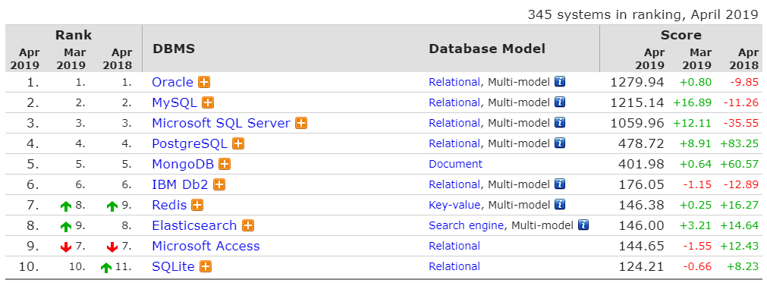
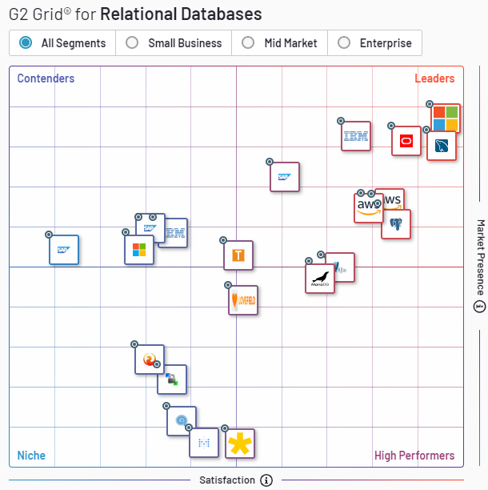
RDBMS
A relational database management system (RDBMS) is a database management system (DBMS) based on the relational model.
https://db-engines.com/en/ranking
https://www.g2crowd.com/categories/relational-databases
Relational (SQL) Databases

Slide 16
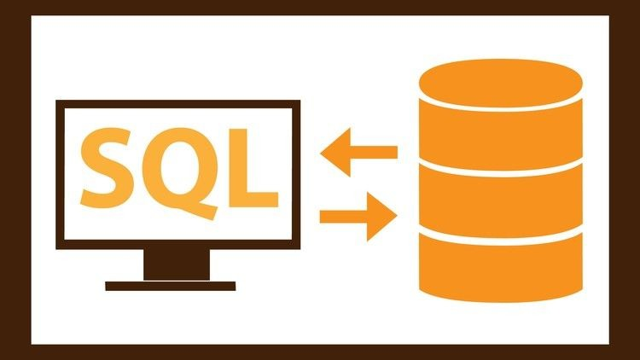
Structured Query Language (SQL)
Data Definition Language
Data Manipulation Language
Data Control Language
Data Types

Slide 17
SQL
Data Definition Language (DDL)
Commands to define the database schema
CREATE / ALTER DATABASE
CREATE / ALTER / DROP TABLE
Data Manipulation Language (DML)
commands permitting users to manipulate data in a database
“CRUD Operations”
Create - INSERT
Read - SELECT
Update - UPDATE
Delete - DELETE
Data Control Language (DCL)
Commands to used to control access to data stored in a database (Authorization)
GRANT
REVOKE
Data Types
Exact Numeric (bigint)
Approximate Numeric (float)
Date and time (datetime)
Character Strings (varchar)
Binary Strings (binary)
Other (XML)
Structured Query Language

Slide 18
Data Definition Language
Create Database, Table - CREATE
CREATE DATABASE Movies;
CREATE TABLE ProductionCompanies (
Id BIGINT PRIMARY KEY IDENTITY(1, 1) NOT NULL, "Name" NVARCHAR(100) NOT NULL,
About TEXT NOT NULL
);
CREATE TABLE Films (
Change Database, Table - ALTER
ALTER DATABASE Movies modify NAME = Cinema; ALTER TABLE Films
ADD About TEXT NOT NULL;
Delete Database, Table - DROP
DROP DATABASE Movies;
DROP TABLE Films;
Id "Name"
BIGINT PRIMARY KEY IDENTITY(1, 1),
NVARCHAR(100) NOT NULL,
ProductionCompanyId BIGINT
REFERENCES ProductionCompanies(Id) NOT NULL
);
Structured Query Language

Slide 19
Data Manipulation Language - CRUD
“SELECT”
“*” gets all columns SELECT * FROM Films
or use specific columns SELECT [Name], About FROM Films
Sort by 1 or more columns SELECT * FROM Films ORDER BY [Name] DESC
Get top rows based on sort SELECT TOP 5 * FROM Films ORDER BY [Name] DESC
“WHERE”
Filter rows SELECT * FROM Films WHERE Id = 1
SELECT * FROM Films WHERE Id between 1 and 3
SELECT * FROM Films WHERE Name = ‘The Godfather’
SELECT * FROM Films WHERE ReleaseDate between ‘2010-1-1’ and ‘2010-12-31’
SELECT * FROM Films WHERE Name like ‘%Godfather%’
Structured Query Language

Slide 20
Data Manipulation Language - CRUD
Strings
Use quote to escape quote in string
“=“ or “like” operators (use “%”)
String manipulation - len(), right(), left(), upper(), …
Integers
> , >= , < , <= , = , between
Dates
> , >= , < , <= , = , between
YYYY-MM-DD format (in single quotes)
getdate() function
Null values
use “is null” (not “= null”)
Isnull() function
Aliases
For fields
For tables
Groups and Aggregates
GROUP BY
Aggregate functions count(), sum(), avg(), min(), max()
Structured Query Language

Slide 21
Data Manipulation Language - CRUD
Add data to Database - INSERT
INSERT INTO ProductionCompanies ([Name], [About]) VALUES ('Castle Rock Entertainment',
'Castle Rock Entertainment is an American film and television production company founded in 1987[1] by Martin Shafer, director Rob Reiner, Andrew Scheinman, Glenn Padnick and Alan Horn. It is a subsidiary of Time Warner''s Warner Bros.'
)
Modify data in Database - UPDATE
Delete data from Database - DELETE
DELETE FROM ProductionCompanies
WHERE Id = 1
TRUNCATE TABLE Films
UPDATE SET WHERE
ProductionCompanies
[Name] = 'Castle Rock Entertainment INC' Id = 1
Structured Query Language

Slide 22

Joins
Regular (INNER)
Left / Right (OUTER)
Cross
SELECT *
FROM Films f
JOIN ProductionCompanies c ON f.ProductionCompanyID = c.Id
Structured Query Language

Slide 23
Data Types
Exact numeric
bigint
numeric
bit
smallint
decimal
smallmoney
int
tinyint
money
Character strings
char
varchar
text
Unicode char strings
nchar
nvarchar
ntext
Date and time
date
Datetimeoffset
datetime2
Smalldatetime
datetime
time
Other data types
cursor
rowversion
hierarchyid
uniqueidentifier
sql_variant
xml
Spatial Geometry Types
Spatial Geography Types
table
Approx numeric
float
real
Binary strings
binary
varbinary
image
Structured Query Language

Slide 24

Movie Database Exercise

Slide 25
Queries
https://www.imdb.com/chart/top?ref_=nv_mv_250_6
Display the name of all Actors whose name starts with John
Display the name of all Films (with the field alias “Film”), together with the Production Company’s Name (with the field alias “Company”) and About (with the field alias “CompanyDetails”)
Add a new WebsiteUser
Add the genres for the first 3 Films in the Categories table, and connect them with the films
Add different scores from each WebsiteUser for each of the first 3 Films
Display films and their average scores
Alter the Films table to create a new date field (“ReleaseDate”)
Update a few rows of the Films table with the ReleaseDate
Display all films that were released between 2005 and now
Movie Database Exercise

